Slide 1
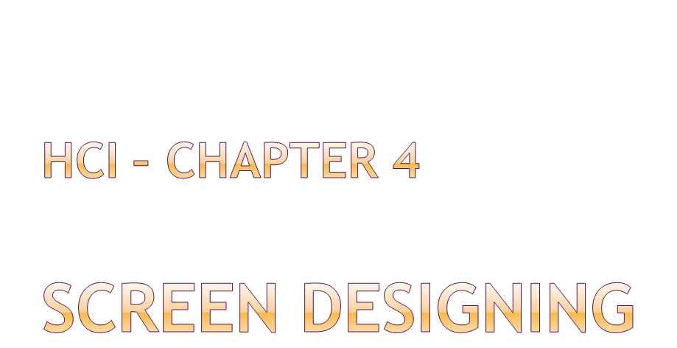

Slide 2

An orderly, clean, clutter free appearance.
An obvious indication of what is being shown and what should be done with it.
Expected information located where it should be.
Clear indication of what relates to what.
Plain, simple language (mostly English).
A simple way to find out what is in a system and how to get it out.
Clear indications when an action can make a permanent change of the system.
Prf.Suresh R. Mestry

Slide 3

UI design goals
  Reduce visual work
  Reduce intellectual work
  Reduce memory work
  Minimise or eliminate any burdens or instructions imposed by technology
  Improved user productivity
Each screen element (controls, text, colour, graphics, animation, message, feedback) must have:
  Meaning to screen users
  Serve a purpose in performing tasks
Prf.Suresh R. Mestry

Slide 4

When display elements are organised in meaningful ways we achieve visual clarity.
Visual clarity is important to recognise screen elements and ignore secondary information.
Clarity is affected by various factors like consistency, ordering of elements, amount of information, groupings, alignment etc.
Prf.Suresh R. Mestry

Slide 5

Provide real-world consistency.
  Experience, expectation, work & cultural conventions.
Provide internal consistency.
  All aspects of the interface observe same conventions and rules.
  E.g., presentation, operation & navigation procedures, visual theme etc.
Follow same conventions or rules across all related interfaces.
Deviate when there is a benefit for the user.
Prf.Suresh R. Mestry

Slide 6

Divide information into logical units that are meaningful.
Provide ordering of screen units based on user’s priority.
Some ordering schemes:
  Conventional
  Sequential
  Function
  Importance/ frequency of use
  General to Specific
Form groups
Only information relative to user’s tasks has to be visible at any point.
Prf.Suresh R. Mestry

Slide 7

Order screen elements in a rhythmic/ natural movement sequence, so it minimises pointer and eye movement.
Locate most important or frequently used elements to top-left.
Maintain top-bottom, left-right movement.
Aligning, grouping and bordering elements adds clarity
Prf.Suresh R. Mestry

Slide 8
Direct attention sequentially through critical, important, secondary and peripheral elements
Allow tab to flow in logical order.
Locate command buttons at end of tabbing
Break information meaningfully only when needed into separate screens, and provide easy links.
Prf.Suresh R. Mestry

Slide 9

Balance:
  Imbalance is discomforting to brain.
  Center the display and distribute equally weighted screen elements on both axis.
Symmetry:
  Eye tends to perceive something as more compact when it is symmetric.
  A unit on one side of the centre line is exactly replicated on the other side.
Prf.Suresh R. Mestry

Slide 10
Regularity:
  Irregularity will make certain elements stand out
  Achieved by aligning elements, maintaining uniform shape, size and colours.
Predictability:
  Unpredictable or spontaneous forces brain to memorise the screen.
  Maintain a conventional order
  Viewing one part of the screen should allow user the predict the remaining part of it.
Prf.Suresh R. Mestry

Slide 11
Sequentiality:
  Eye tends to move to the most emphasised or topmost element first and then move sequentially to right or down.
  Randomness causes confusion.
Economy:
  Heavy colours, designs and shapes detracts from clarity.
  Have just enough display elements to communicate the message and finish the task.
Prf.Suresh R. Mestry

Slide 12
Unity:
  Fragmentation forces brain to remember more and hence leads to confusion.
  Grouping similar shapes and colours promote unity. Proximity between elements also affect.
Proportion:
  Adds clarity
  Some aesthetically pleasing proportional shapes are –
    Square (1:1)
    Square root or two (1:√2)
    Golden rectangle (1:1.618)
    Square root of three (1:√3)
    Double (1:2)
Prf.Suresh R. Mestry

Slide 13
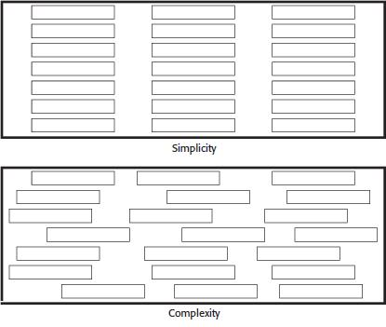
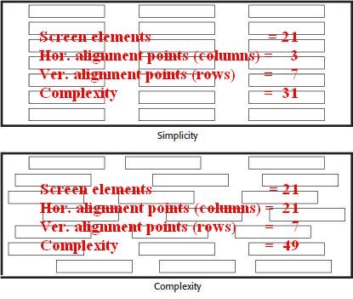
Simplicity:
  Complexity of a task can be reduced with the simplicity of a UI
  Border each element and align them.
  Minimise the number of screen elements
  Complexity of a screen can be calculated as the sum of
    Screen elements
    Horizontal alignment points
    Vertical alignment points
Prf.Suresh R. Mestry

Slide 14
Groupings:
  Aid in structuring and adds meaning. This helps faster recall of instructions.
  Group elements based on their functions
  Elements can be grouped together using:
    White space (proximity)
    Borders
    Backgrounds
Prf.Suresh R. Mestry

Slide 15

Proper amount of information:
  Too much information can be confusing, as there will be too many elements seeking user’s attention.
  Too less information can also be confusing, as user will have to refer to many screens to complete one task.
Present all necessary information:
  All information needed to perform any task or take a decision has to be present on the same screen.
Prf.Suresh R. Mestry

Slide 16

Screen density:
  Density and complexity are proportional as both calculate “how much is there”.
  Overall density:- a measure of “percentage of character positions on the entire screen containing data”. This is a proportion of the amount of characters on the screen to the amount of empty space.
  Local density:- a measure of “how tightly packed the screen is”. Here the local density is calculated for every character on the screen, and the average of all characters becomes the local density of the screen.
Prf.Suresh R. Mestry

Slide 17

Minimise page length
Place critical or important information at the top, so it is always visible when the page is opened.
Long page or short page?
  To find specific information quickly.
  To understand an entire concept.
  To print all or most of the content.
  e-books over slow connections.
Prf.Suresh R. Mestry

Slide 18

Scrolling:
  Avoid scrolling as much as possible.
  Minimise vertical scrolling.
  Suggest within the top part of the page that it needs to be scrolled down to view entire contents.
  Avoid horizontal scrolling.
Paging:
  Encourage paging: page-up, page-down keys should help scrolling.
Prf.Suresh R. Mestry

Slide 19

Visually emphasise
  Most prominent/ frequently used element.
  Most critical element.
  Central idea or focal point.
Ensure emphasised elements stand out:
  Avoid emphasising too many elements
  Avoid using too many emphasis techniques
  Avoid screen clutter
De-emphasise less important elements.
Emphasise new/ changed content in a web-page.
Prf.Suresh R. Mestry

Slide 20

To emphasise elements, we can use:
  Brightness
  Reverse polarity
  Fonts
  Underling
  Blinking
  Line rulings and surrounding boxes or frames
  Colours
Prf.Suresh R. Mestry

Slide 21

Legibility
Readability
Usability
Contrasting display features
Visual lines
consistency
Prf.Suresh R. Mestry

Slide 22

Font types and families
Font size
Font styles and weights
Font case
Consistency
Prf.Suresh R. Mestry

Slide 23

Captions/ labels
  Identify controls with captions
  Structure and size
  Significant word capitalisation
  Designate with a colon (:)
  Distintiveness
Data fields
  Entry/ modifiable fields
  Display/ read-only screens
  Visual emphasis
Prf.Suresh R. Mestry

Slide 24

Data is presented in a graphical format, as in, charts or graphs.
Helps in understanding data and analysing it faster.
Should be reserved for large sets of data.
Graphics are not required to display linear data.
Prf.Suresh R. Mestry

Slide 25

Emphasise the data, minimise non-data elements
Data variation
Proper context
Restrict no. of information carrying dimensions
Maximise data density
Avoid unnecessary embellishment.
Prf.Suresh R. Mestry

Slide 26

Values on an axis should increase as they move away from the origin
Use horizontal axis to show time
Use vertical axis to show the effect
Origin shall be at the bottom left of the graph. Only if negative values exist, the origin should be the centre of the graph.
Prf.Suresh R. Mestry

Slide 27

Linear scale
Scale markings
Start a numeric scale at zero, others likewise.
Minimisation of scale digits
Single scale on each axis
Duplicate axes for large matrices
Scale interpretation
Labeling
Consistency
Prf.Suresh R. Mestry

Slide 28

Data lines should be the heaviest
Axes lines should be of medium weight
Grid lines should be the lightest or absent.
Prf.Suresh R. Mestry

Slide 29

Clear and detailed
Left-to-right
Integrate
One typeface
Separation
Source
Legends
Prf.Suresh R. Mestry

Slide 30

Short, simple, clear and distinct.
Describe the purpose of the graphic.
Should be on top, centered or left-aligned.
Do not use abbreviations. Spell out fully.
Use Title-Case or UPPER-CASE.
Prf.Suresh R. Mestry

Slide 31
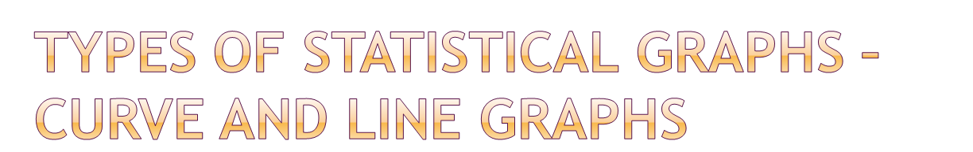
Single graph
Maximum four to five
Label identification
Legend
Important or critical data
Comparing actual and projected data
Data difference
Prf.Suresh R. Mestry

Slide 32
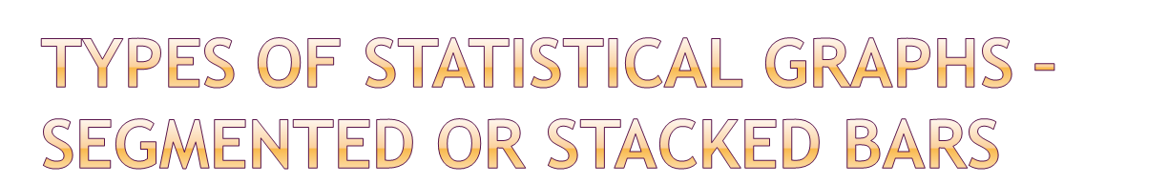
Data category ordering
Large segments
Coding schemes
Labeling
Prf.Suresh R. Mestry

Slide 33
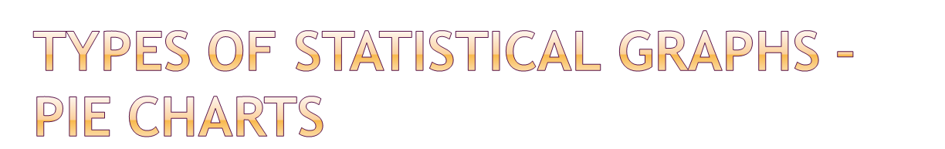
Total 100 percent
Five segments or fewer
Minimum five percent
Start at 12:00
Labeling
Numbers with segment labels
Segment coding
Highlighting
Tilting
Prf.Suresh R. Mestry

Slide 34

Determine what kind of information is most important to the user.
Choose the type of graph suited for presenting that kind of information.
Prf.Suresh R. Mestry

Slide 35

Order of steps
Orientation
Coding conventions
Arrows
Highlighting
Only once decision at each step
Consistently order and word all choices
Prf.Suresh R. Mestry

Slide 36

System power
Screen size
Screen resolution
Colours
Platform compatibility
Style guide compatibility
Prf.Suresh R. Mestry

Slide 37

Browsers
  Compatibility
  Monitor size and resolution
  Fonts
  Colour
  Bandwidth
  Versions
Others
  Downloading
  Current information
  Page printing
  Maintainability
Prf.Suresh R. Mestry

Slide 38

Prf.Suresh R. Mestry

